Slide 1



UNIT 2: Home is where heart is
My room

Slide 2
Check your VOCABULARY
https://wordwall.net/embed/ccb3925651714ddba728b966c7344ff2?themeId=0&templateId=22%27%20frameborder=%270
https://quizlet.com/297358239/rooms-and-furniture-flash-cards/

Slide 3
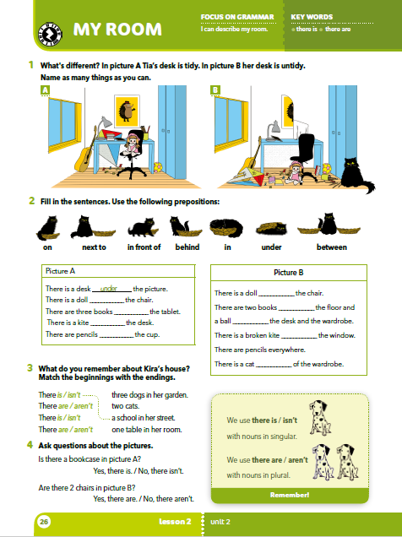
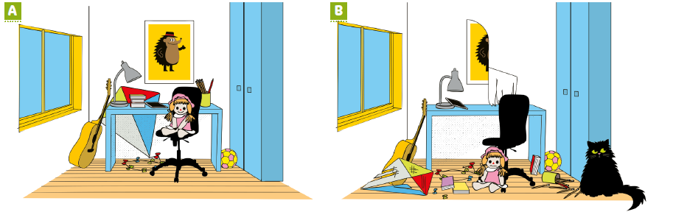
Describe the pictures. What’s different?
In picture A the desk is tidy. In picture B the desk is untidy. Who do you think made the mess?

Slide 4
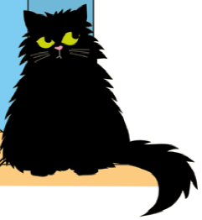
Where is Jinx?
https://wordwall.net/embed/a1a2ecbe334445efb554acc99951f863?themeId=0&templateId=22%27%20frameborder=%270

Slide 5







Prepositions
on - in -
next to - under -
in front of - between -
behind -
na
u
pokraj
ispod
ispred
između
iza

Slide 6
Read the sentences and follow the instructions.
Put your pencil on your nose.
Put your pencil in front of your nose.
Put your pencil under your hand.
Put your pencil case between your feet.
Put your pencil in your shoe.
Put your pencil between the book and the notebook.
Put your pencil behind your head.

Slide 7
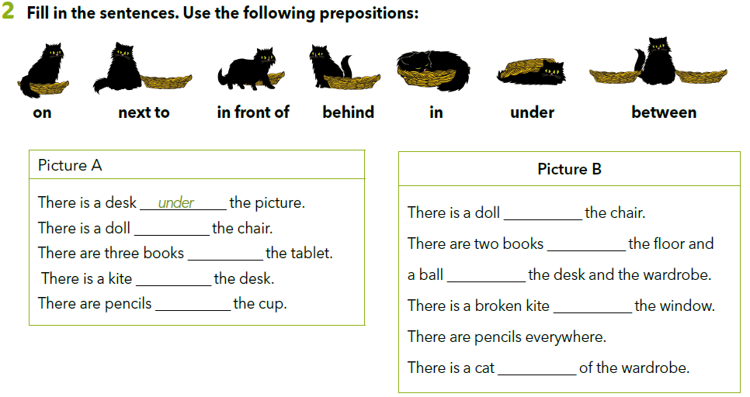
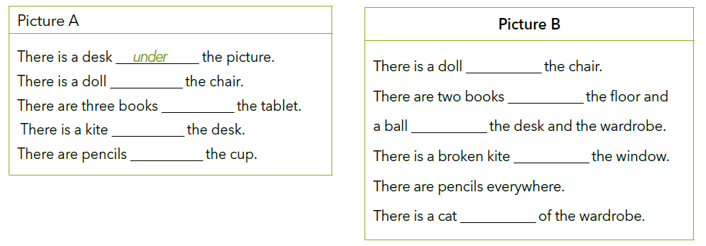
under
on
on
next to
behind
between
in
under
in front of

Slide 8
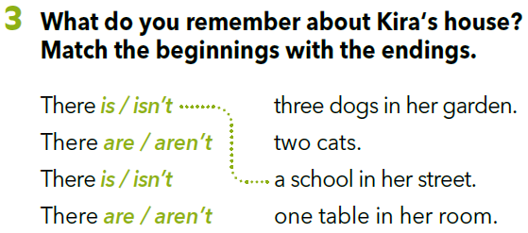

Slide 9
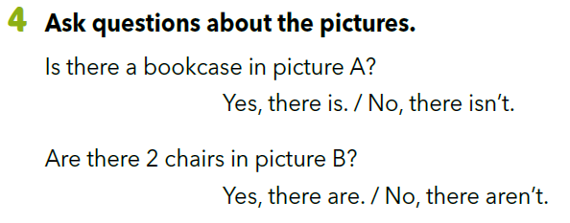
Read the questions and circle the correct answer.

Slide 10
There is a cat.
There are pencils.
There isn’t a dog.
There aren’t two chairs.
There is one chair.
There are three books.
There isn’t a bookcase.
There aren’t two guitars.
We use ”there is” with singular nouns.
Singular nouns.
Plural nouns.
We use ”there are” with plural nouns.

Slide 11
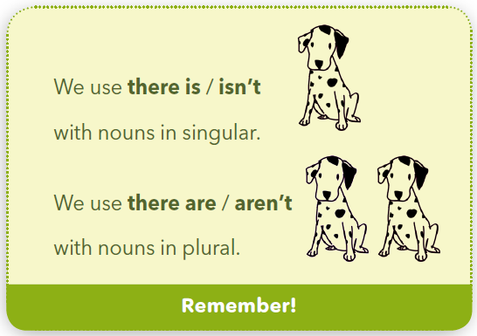

Slide 12
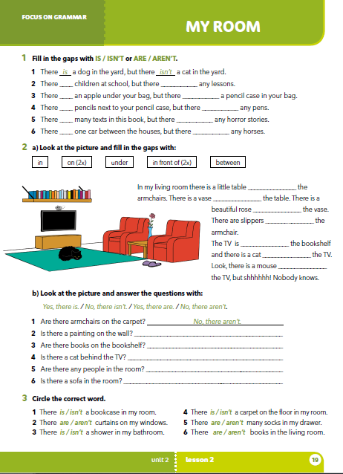
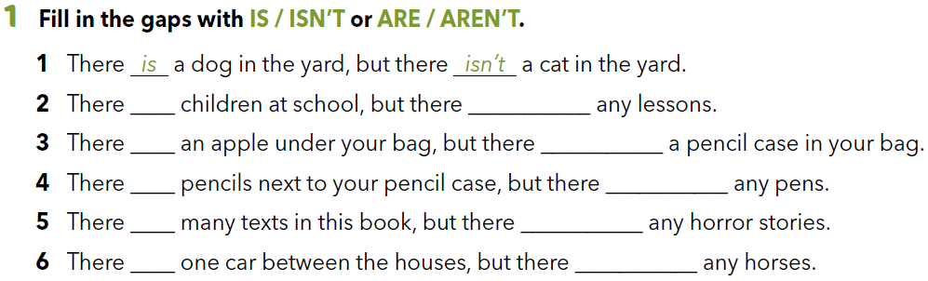
Workbook p 19.
are
aren’t
is
isn’t
are
aren’t
are
aren’t
is
aren’t

Slide 13
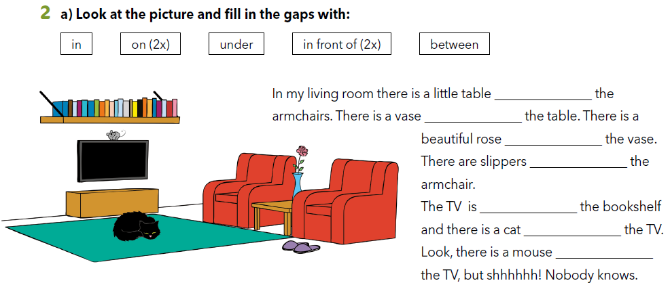
Fill in the gaps with the prepositions given.
Nadopuni rečenice s ponuđenim prijedlozima.
between
on
in
in front of
under
in front of
on

Slide 14
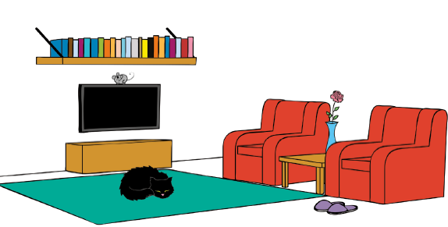
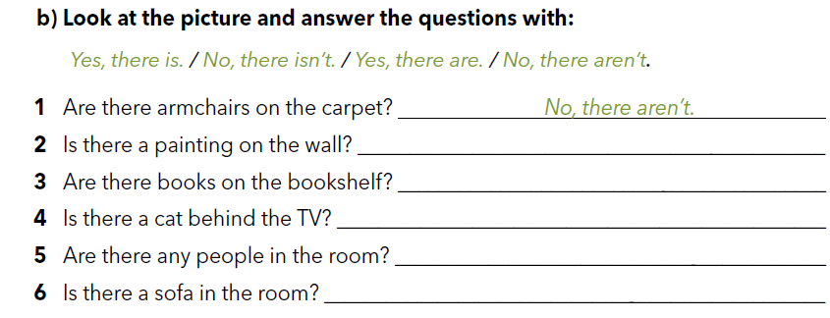
No, there isn’t.
Yes, there are.
No, there isn’t.
No, there aren’t.
No, there isn’t.

Slide 15
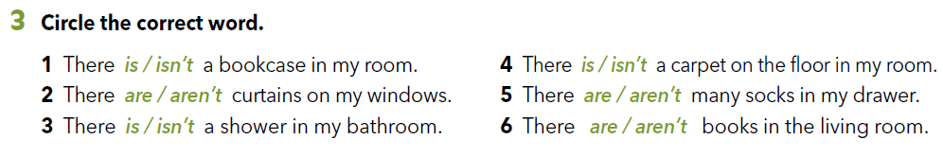
Describe your home.

Slide 16

LEARN MORE.
https://www.e-sfera.hr/dodatni-digitalni-sadrzaji/63d6faea-8e63-40e5-a374-d8f9eff3a5c7/
My favourite room
Read the text. Compare your home to Akira’s and describe it by answering the questions below the text.

